Slide 1
CUTe 3.0
Bankruptcy Prediction
BY :
Sai Subrahmanyam Janapati
Richa Pandey
Aman Kumar

Slide 2
Problem Statement:
The given data contains details of various markets and financial ratios of entities. Target variable is whether the company got bankrupt in the subsequent years or not. Using the data build appropriate model to ascertain the bankruptcy of entity.
OBJECTIVE :
Given the financial ratio of entities, predict whether a company would go bankrupt or not.
Use f1 score as the evaluation metric.

Slide 3
Literature Review
Read discussion forums which described the problem statement more in detail.
Found out multiple approaches that could be used to solve this challenge.
Helped us realize in advance that our dataset needs a good amount of pre-processing.
Discovered the imbalance nature of the given data.

Slide 4
Model approach
Goal
Predict whether the company would get bankrupt or not
Get Data
Read dataset into Python, R
Data
Pre-processing
Missing Data, Imbalanced Data
Statistics &
Analysis
95% Not-bankrupt , 5% Bankrupt
Submit Predictions
Evaluation Metric – F1 Score

Slide 5
Exploratory data analysis : Correlation plot

Slide 6
Exploratory data analysis : Outlier Detection

Slide 7
Exploratory data analysis : Data distribution

Slide 8
Exploratory data analysis : imbalance data
Techniques to treat imbalanced data:
SMOTE
ROSE
RANDOM UNDERSAMPLING
NEARMISS
CONDENSED NEAREST NEIGHBOURS
EDITTED NEAREST NEIGHBOURS

Slide 9
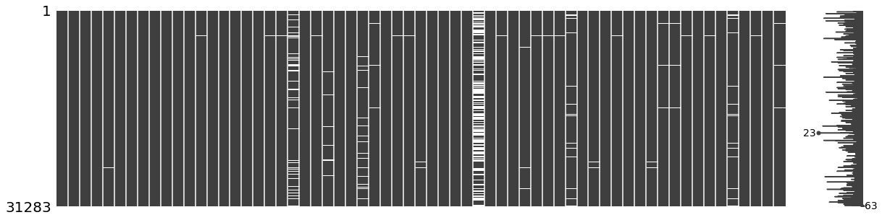
Missing values visualization

Slide 10
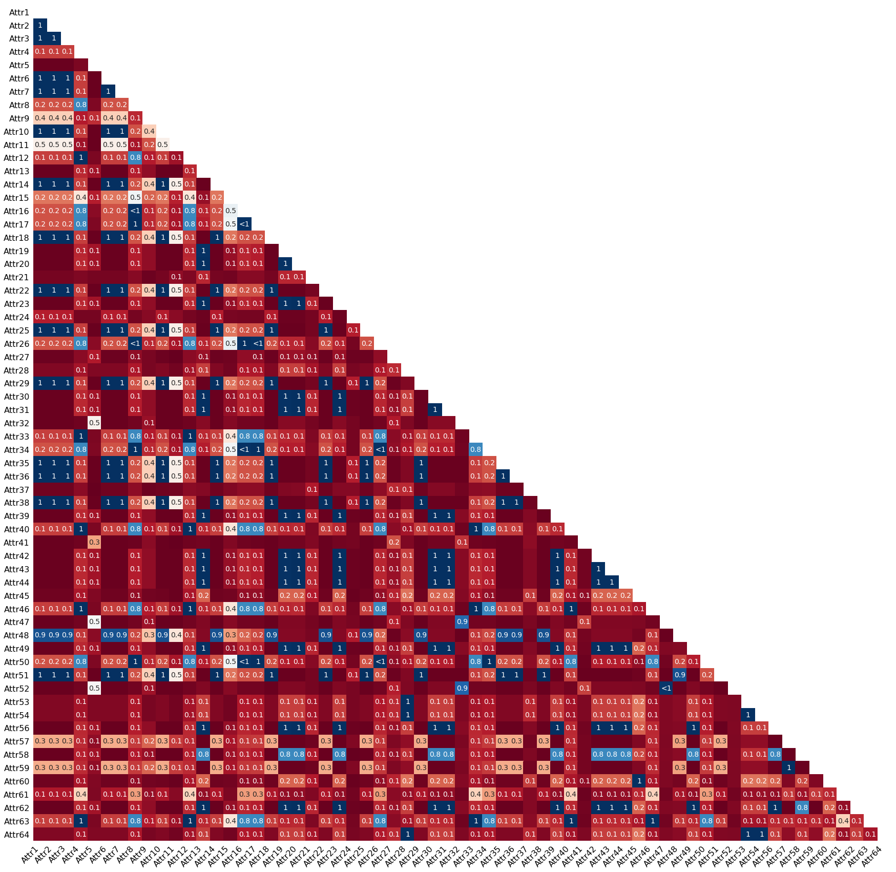
Feature Correlation heatmap for missing values

Slide 11
Feature importance

Slide 12
DATA PRE-PROCESSING
Removed Column ‘ ID ’.
Identified the columns with Na/NaN values.
Removed column ‘Attr37’ as it mostly had missing data.
Imputed the missing values with mean values of the columns containing Na values.
Treated the outliers detected in few observations.
Used SMOTEENN to treat the imbalance distribution of class in the target variable.
Standardized the data.

Slide 13
Data modeling
Logistic Regression
Random Forest
SVM
AdaBoost
XGBoost
GBM
CATBoost

Slide 14
PIPELINE FOR DATA MODELING
Raw data
Removal of insignificant features
Mean imputation
Outlier Removal
SmoteENN Oversampling
Modelling with 7 models :
(Logistic Regression, RF, XGBoost, GBM, CATBoost, AdaBoost)
Prediction Results

Slide 15
Model building : flow
Logistic Regression
VIF
StepAIC
Bagging with baseline model
Re-Sampling
Random Forest
Boosting
CATBoost
XGBoost
ADABoost
GBM
Stacking

Slide 16
Wait…

Slide 17
Final model selection : XGBoost
Hyper – Parameter Tuning
Confusion Matrix
col_sample_bytree = 0.5
n_estimators = 600
max_depth = 10
learning_rate = 0.05
gamma = 1
alpha_reg = 0.5
reg_lambda = 0.5
scale_pos_weight = 1.196
min_child_weight = 5
0
1
F1 Score
0
5885
40
0.67
1
156
174

Slide 18
Future work
It is possible to gather more core features and synthesize more features by varying the arithmetic operations performed on these core features.
Also it is possible to synthesize more features considering the current features as base features.
Better domain knowledge would contribute in a better understanding of features which would result in better prediction.
In future it should be made sure that the data collected should be less sparse.

Slide 19
Thank You!

